Slide 1
OATS and All Pairs Tool

Slide 2




What you will learn today?
His name
All Pairs
When to use it
When NOT to use it

Slide 3
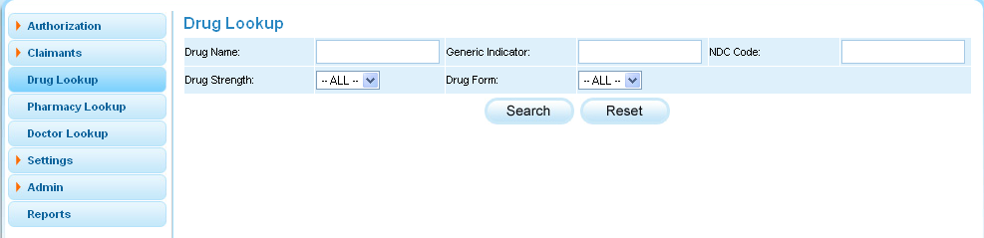
Example – For your consideration:
3 textboxes and 2 list boxes
Drug Name | Generic Indicator | NDC Code | Drug Strength | Drug Form
Blank | Blank | Blank | All | All
Valid | Valid | Valid | Any | Any
Invalid | Invalid | Invalid
To try all combinations of 5 variables with all values each would require 3x3x3x2x2 = 108 tests.

Slide 4

Not…Not…Not…
Not Possible
Not Feasible
Not Cost effective
To test a system using :
All possible variations and
All possible combinations
of test parameter inputs.

Slide 5

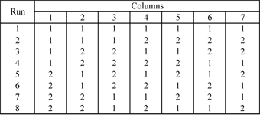
Taguchi’s Orthogonal arrays
  An example of a Taguchi's L8 orthogonal array:
This design can be used to estimate seven main effects using eight runs.
This array is similar to the 2 design

Slide 6
All Pairs
All pairs tables are a simpler and often more compact alternative to orthogonal arrays
“The pair-wise coverage property of OA gives best results for test subjects where there are many valid values of each parameter…”
Mats Grindal, Birgitta Lindstrom, Jeff Offutt, and Sten F. Andler, "An Evaluation of Combination Testing Strategies," Empirical Software Engineering 11, no. 4 (December 2006): 583–611.

Slide 7
A Simple Assumption
Most bugs will arise from single options for any given factor or from pairs of options across pairs of factors
Bugs will not arise from triples of options, quadruples of options, or other high-order combinations of options.
Drug Name | Generic Indicator | NDC Code | Drug Strength | Drug Form
Blank | Blank | Blank | All | All
Valid | Valid | Valid | Any | Any
Invalid | Invalid | Invalid

Slide 8
Solution to the Example
The tool has suggested 13 test cases only. A reduction by 88%.
case | Drug Name | Generic Indicator | NDC Code | Drug Strength | Drug Form
1 | Blank | Blank | Blank | All | All
2 | Blank | Valid | Valid | Any | Any
3 | Valid | Blank | Valid | All | Any
4 | Valid | Valid | Blank | Any | All
5 | Invalid | Invalid | Invalid | All | All
6 | Invalid | Blank | Invalid | Any | Any
7 | Blank | Invalid | Blank | Any | Any
8 | Valid | Valid | Invalid | All | ~Any
9 | Invalid | Valid | Valid | ~All | All
10 | Blank | Invalid | Valid | ~Any | ~All
11 | Valid | Invalid | ~Blank | ~All | ~Any
12 | Invalid | ~Blank | Blank | ~Any | ~All
13 | Blank | ~Blank | Invalid | ~All | ~All

Slide 9

Maximum Coverage – Minimum Tests
You may not necessarily reduce the total amount of testing, but OATS may help cut down on the test design effort.

Slide 10
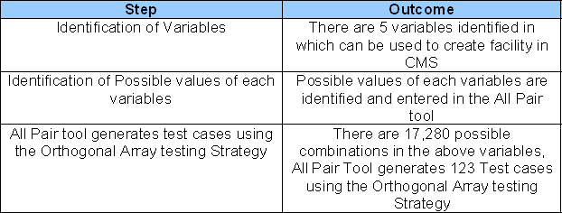
Use of All Pair tool in EWL CMS Integration Project
Project Objective : There were 7 new fields introduced in DB2 table, These fields were to be tested with different combinations of data (facilities created in CMS).
Motive of using All Pair Tool : Manual method of finding out various combinations of data would be tedious and time consuming since there were many variables in data (facility) creation with many values, and would require many test cases to cover all combinations.
All Pair tool comes up with minimum combinations of variables which provides maximum coverage.
Below are the steps followed to find out the combinations

Slide 11
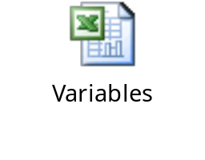
Input to All Pair tool in EWL CMS Integration Project
QA team identified 5 variables to create data (facilities),
  Variable - Status which takes 8 possible values
  Variable – Borrower Option takes 27 possible values
  Variable – TNX Indicator takes 2 possible values
  Variable – Currency takes 5 possible values
  Variable – Authorized Limit takes 8 possible values
Spreadsheet shows variables and possible values identified in the data creation
These above variables are given as input in the All Pair Tool

Slide 12
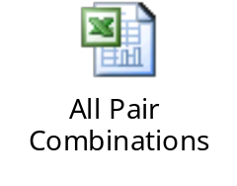
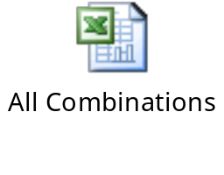
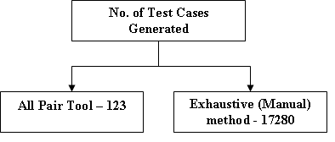
Output Generated by All Pair Tool
All Pair Tool generates below output, It contains 123 best combinations to provide maximum coverage.
Exhaustive (Manual) method comes up with 17,280 combinations to cover the requirements shown below.

Slide 13
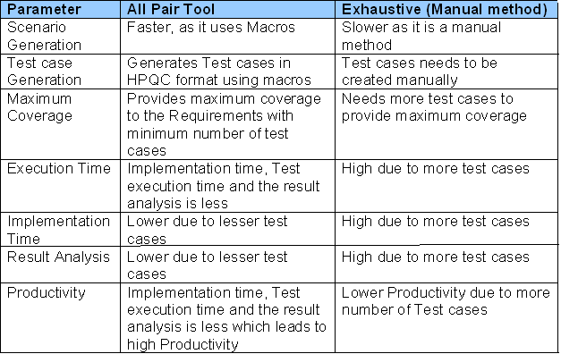
Comparison between All Pair tool and
Exhaustive (Manual) method

Slide 14
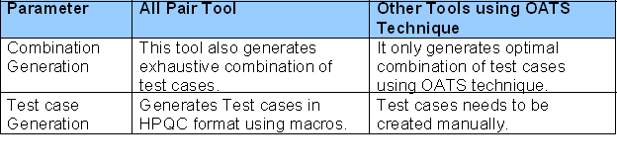
Comparison between All Pair tool and other tools using OATS Technique
There are several number of tools available which uses the OATS (Orthogonal Array Testing Strategy) technique.
All these tools generates optimal number of test cases providing maximum coverage to the requirements.
List of other tools available:
  OATSGen
  Reduce Array2
  IPO
  Test Vector Generator
Difference between All Pair and other tool available:

Slide 15
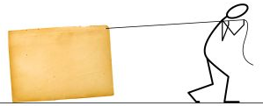
Statutory warning #1
Avoid applying OATS and All Pairs manually. Creating the matrices with the different combinations is time consuming and subject to manual errors.
Hence iGATE has implemented this logic using a tool.

Slide 16
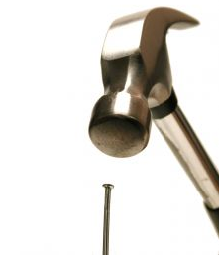

Statutory warning # 2
Avoid from focusing the whole focus of the testing effort to All Pairs.
Think of other testing techniques such as boundary values, equivalence classes too to cut down the number of test cases.

Slide 17

Statutory warning # 3
Think before applying All Pairs alone for high-risk applications.
This is NOT a technique that allows for exhaustive testing.

Slide 18

Statutory warning # 4
You might be picking the wrong parameters to combine!
All Pairs is only a tool.
It relies on the tester's comprehensive knowledge of the complete system to be most effective.

Slide 19



Thank you!

